Slide 1
State Accounting Business User Group (BUG)
Thursday, May 28, 2020
2:00 PM – 4:30 PM
WebEx only

Slide 2
Agenda
Announcements & Reminders
Presentations
Welcome
Send questions to Chad through chat
Introductions: Kevin Le & Chad Pinger
Coronavirus Accounting Update
Deactivation of user IDs upon employee termination
Object 521400 on OCIO IBTs
Batches in ERROR status
Requests for State Accounting
Encumbrances
Fiscal Year End Schedule
Financial Reporting Package
Unposted Fixed Assets

Slide 3
Announcements
Coronavirus Accounting Update
State Response
March 25, 2020
LB1198
$83,619,600 transferred from the Cash Reserve Fund
To aid in carrying out the goals of the Governor’s Emergency Program

Slide 4
Announcements
Coronavirus Accounting Update
Federal Response
March 6, 2020
Coronavirus Preparedness and Response Supplemental Appropriations Act
$8.3 Billion Federal Aid package
Vaccine development and public health funding

Slide 5
Announcements
Coronavirus Accounting Update
March 18, 2020
Families First Coronavirus Response Act (FFCRA)
$104 Billion Federal Aid package
Emergency sick leave and FMLA provisions effective April 2, 2020
$1 Billion unemployment insurance expansion

Slide 6
Announcements
Coronavirus Accounting Update
March 27, 2020
Coronavirus Aid, Relief, and Economic Security (CARES) Act
$2.2 Trillion Federal Aid package
Employer OASDI deferral
$150 Billion to States
$1.25 Billion to Nebraska

Slide 7
Announcements
Coronavirus Accounting Update
April 24, 2020
Paycheck Protection Program and health Care Enhancement Act
$484 Billion Federal Aid package
Replenish the Paycheck Protection Program (PPP) for small business
Public health measures for virus testing and hospital funding
What’s next?
General state aid for lost revenues?
Infrastructure?

Slide 8
Announcements
Deactivation of user IDs upon employee termination
http://das.nebraska.gov/personnel/user_guides/ewoc/terminateanemployee.pdf
Workday
Needs to be done right away for security purposes, this has been an audit finding for several years

Slide 9
Announcements
OCIO IBTs
All OCIO IBTs should be coded to 521400 CIO Charges
Only exception is for a Fixed Asset (58****) purchase by OCIO for an agency
Memo would accompany the IBT giving the agency detail on the purchase

Slide 10
Announcements
Batch in ERROR status
Run report R5514001 ‘G/L Post Budget Failure Report’
Before contacting State Accounting for assistance
Gives you error code and explanation
Menu path: Accounting>Manage Journal Entry>JE Review/Approve/Post>G/L Post Budget Failure Report

Slide 11
Announcements
Requests for State Accounting
Always send requests through as.stateaccounting@nebraska.gov
If you are used to working with a specific person you are welcome to cc them
Requests that are sent only to a specific teammate could easily get missed or delayed

Slide 12
Questions?

Slide 13
Encumbrances
Sheryl Hesseltine

Slide 14
Valid Encumbrance: 81-138.01
Salaries have been earned and are payable to the employees, but have not been paid as of the end of the biennium as a result of pay periods not being consistent with the end of the biennium, except that higher education institutions may encumber payrolls for the remainder of the summer session which is in progress at the end of the state’s biennium if they have been budgeted and appropriated in such manner

Slide 15
Payroll Encumbrances (Mid Biennium)
Manual encumbrances in the PB ledger
State Accounting will prepare and enter the payroll encumbrances
Entry will be based on 100% of July 1st biweekly payroll and 70% of the July 15th biweekly payroll
Will not include Health, Life and AD&D insurances
Encumbrance entry will be done after July 15th payroll has posted
You will see these encumbrances on your allotment status and budget status reports until they are liquidated after the certification process

Slide 16
Certified Encumbrances
Agencies will review their Mid-Biennial Carryover Report as of 7/31 and 8/14. The 8/31 Biennial Carryover Report will be signed by agency director and sent to State Accounting and this certifies the encumbrances.
Due date is Friday September 18, 2020
After the certification process is complete State Accounting will liquidate the payroll encumbrances we entered

Slide 17
Mid-Biennial Carryover Report
This will be run according to Fiscal Year End Closing Schedule
As of 7/31/2020 – agency review for corrections
As of 8/14/2020 – agency review for corrections
As of 8/31/2020 – this will be the Certified copy, director signature, submit by Sept 18, 2020
Totals should match Encumbrance detail report and should be only valid encumbrances

Slide 18
Prior Year Voucher Processing Menu
Use the prior year voucher processing menu throughout the year
Accounts Payable>Prior Year Voucher Processing>PY Voucher Entry
This is used to identify all accounts payable where goods or services were received in the prior fiscal year

Slide 19
Questions?

Slide 20
Questions?
http://das.nebraska/accounting
Administrator’s Correspondence; closing schedule
Accounting Policies; state accounting manual (section 11, encumbrance policy)
http://www.nebraskalegislature.gov/laws/browse-statutes.php ; statutes 81-138.01 – 81-138.04
Sheryl Hesseltine
sheryl.hesseltine@nebraska.gov
402-471-0610

Slide 21
Schedule of Expenditures of Federal Awards (SEFA)
Sheryl Hesseltine

Slide 22
SEFA
Agencies that receive Federal funds will get an email from State Accounting to verify the amount of Federal expenditures and sub-recipient expenditures in E1 for each federal award.
An email will be sent around the first of July and a response will be due within a month.

Slide 23
Fiscal Year End Schedule
Sheryl Hesseltine

Slide 24
Friday, June 5, 2020
Review open manual encumbrances

Slide 25
Monday, June 8, 2020
Review Service PO’s (O9, Z8, or X6)
Review of Received Not Vouchered (211700)
Open Purchase Orders
Petty cash funds and vendor deposit accounts
Review of all balance sheet accounts (100000-399999)

Slide 26
Thursday, June 11, 2020
Bi-weekly payroll (B12) due for certification

Slide 27
Tuesday, June 23, 2020
June monthly payroll due for certification

Slide 28
Thursday, June 25, 2020 (procurement roles will be taken away at 5:00 p.m.)
Bi-weekly payroll (B13) due for certification
Unposted Fixed Asset Report
Fixed Asset No Cost Integrity Report
All Service PO’s (O9, Z8, or X6)
Manual Encumbrances from prior year - liquidate
Allotment Status Report
Review any outstanding cash transactions related to the Treasurer’s office
LAST DAY TO POST FISCAL YEAR END 6/30/20 TRANSACTIONS

Slide 29
Monday, June 29, 2020
No purchasing activity without authorization from Materiel. Do not perform a receipt function against an outstanding purchase order for current period or a future period unless authorized since these must be posted before year-end.
Only volume voucher payments and emergency payments.
Line Type 4 – vouchers with July 2020 GL dates, do not adjust voucher amount until July
Legally required expenditures for E1 Fiscal Year 19 (July 1, 2019 to June 30, 2020) will be allowed to post only with prior notification and approval by State Accounting

Slide 30
Tuesday, June 30, 2020
Treasurer’s Office cut off for deposits – 9:00 A.M.
Requirements may be altered if we are still in a direct agency deposit to bank situation
No purchasing or posting activities
If there are outstanding issues for your agency that will have a financial impact, contact Sheryl Hesseltine by 12:00 P.M.
E1 will be shut down for all agencies at 4:00 P.M.
Outstanding purchase orders (not received) will be rolled over to the new fiscal year

Slide 31
Wednesday, July 1, 2020
NO POSTING UNTIL FLASH MEMO IS RECEIVED THAT YEAR END CLOSE IS COMPLETE – ANTICIPATED BY WEDNESDAY, JULY 1, 2020 AT 7:00 A.M.
First allotment of new fiscal year appropriations provided by Budget Division
Prior year voucher processing when appropriate
July 1, 2020 Allotment Status Report
Review open Purchase Orders to be sure rollover is correct

Slide 32
Thursday, July 2, 2020
Prior year manual encumbrances that were voided (to be carried over) may be re-entered
Start entering valid manual encumbrances
Encumbrance Detail Report

Slide 33
Wednesday, July 15, 2020
State Accounting will calculate accrued payroll based on July 1st and July 15th biweekly payrolls
July 1st payroll is 100% June hours
July 15th payroll is 70% June hours
Contact State Accounting if you use a different method or have questions

Slide 34
Friday, July 31, 2020
Complete entry of E1 Fiscal Year 20 budgeted amounts for the Budget Status Report

Slide 35
Mid-Biennial Carryover Reports
First draft as of 7/31/20 – run on Monday, August 3, 2020
Second draft as of 8/14/20 – run on Monday, August 17, 2020
Certified version as of 8/31/20 – run on Tuesday, September 1, 2020
Certified Biennial Carryover Report (signed copy) due to State Accounting by Friday, September 18, 2020
Blank reports must be sent in as well

Slide 36
Wednesday, September 30, 2020
State Budget division completes review of certified encumbrances
Re-appropriation provided as appropriate
After certification process completed, State Accounting will liquidate payroll encumbrances that we entered

Slide 37
Questions?

Slide 38
Reminders Chart of Accounts
Do not use object 583300
5834** object codes
583400 IT HARDWARE EQUIPMENT has been inactivated on E1
Agencies should now be using the 583410 – 583470 object range according to the type of equipment purchased
The purpose of this was to record at a more detailed level
Note: The descriptions in the Chart of Accounts on State Accounting’s website are currently being updated

Slide 39
Reminders
583410 SERVER EQUIP
583420 MIDRANGE COMPUTING EQUIP
583430 MAINFRAME COMPUTING EQUIP
583440 DATA STORAGE EQUIPMENT
583450 NETWORKING EQUIPMENT
583460 VOICE EQUIP
583470 PERSONAL COMPUTING EQUIP
583480 VIDEO EQUIP
583490 RADIO EQUIP

Slide 40
Questions?

Slide 41
Financial Reporting Package
Shannon Muffly

Slide 42
Financial Reporting Package
Memo, instructions, definitions and forms
Sent to all agencies first week of July, due to Chad Pinger by August 14, 2020
If nothing to report, please let us know that you have reviewed all forms and agency has nothing to report
Please include Agency # on forms or in email
4 new forms
Information/instructions included
Questions – contact Sheryl Hesseltine

Slide 43
Financial Reporting Package-Forms
Memo, Instructions, and Definitions
Accrual Repsonses (2 tabs)
Cash and Investments
Non-Monetary
Leases (3 tabs)

Slide 44
Financial Reporting Package-Forms
Construction-In-Progress (3 tabs)
Construction Commitments (2 tabs)
Irrevocable Split Interest Agreements
Service Concession Agreements

Slide 45
Submitting Forms
Agency # and contact information
If nothing to report, let us know by email
Responses/Forms due August 14, 2020
Submit to Chad Pinger at as.stateaccounting@Nebraska.gov with the subject ‘Financial Reporting Package’.

Slide 46
Questions?

Slide 47
Fixed Assets
Kevin Le

Slide 48
Procurement
Planners: setting stage with PO creation
Detail lines most important:
Single or multiple items
Fixed Asset object code “58”
Payees:
3 way match and O Batch
(let this post before PV!)
Creates first relationship with Fixed Assets & G/L
Adds transaction to Unposted FA report
Accounting
Fixed Assets
Foundation of the asset (multiple people)
Create the Asset Masters
Monthly review of Unposted FA Transaction report & FA No Cost Integrity report
Post costs to Assets
Notes:
The 3 Pillars of an asset:
Procurement: Single or Multiple PO lines: single line-easy post for FA, one line with multiple items will be a FA split to assign costs to each item
Accounting: starts with receipting of the PO. Receipting PO creates OV batch, make sure this has posted before the PV batch is created.
Fixed Assets: begins with creating the Asset Master

Slide 49
Creating an Asset Master

Slide 50
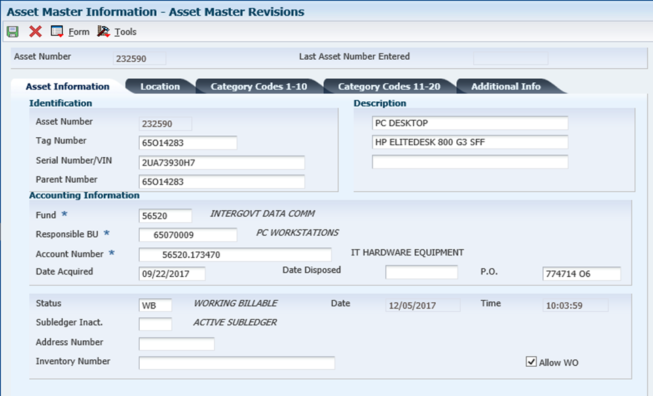
The Fixed Asset tag number should match the agency and division. The tag number should also match the responsible business unit.
(In this example, agency 65)
Fund:
Not sure? Skip to responsible BU, use magnify glass to search for fund paired to BU.
Account #: fund # and 17xx00
xx=from digits 3 & 4 in the OC
Ex. 65070009.583470
Acct # for FA= 56520.173470
Remember to enter PO #
Notes:
Start with FA Tag #
How to find fund
Acct #-how to find. Next slide-why is this important?

Slide 51
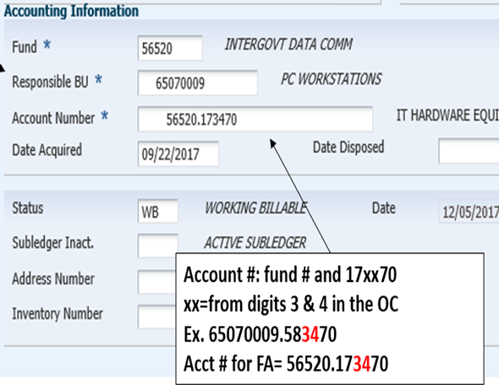
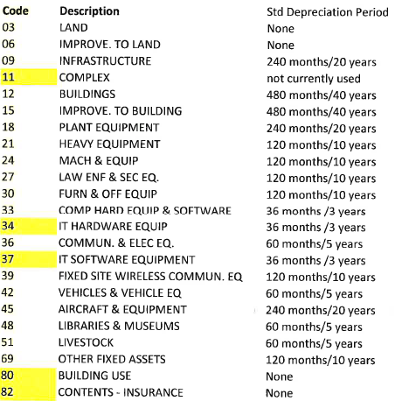
Notes:
Within the Acct #, #’s 3 and 4 relative to 2 parts of the asset *Depreciation-see coding
*Item Code-next slide

Slide 52
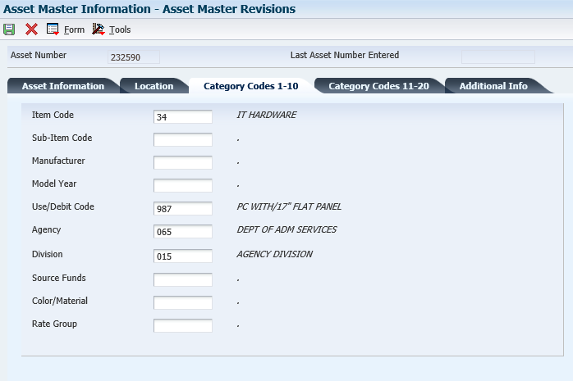
Item Code: auto filled from the Asset info tab
Both must be entered

Slide 53
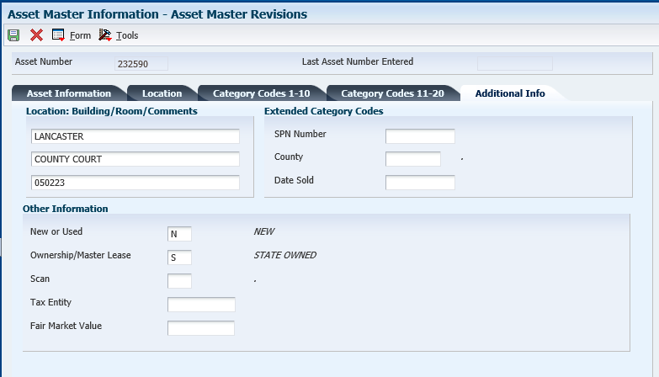
Both fields should be entered
Notes:
Save Asset Master. E1 will then auto assign an asset # to the TAG you just created.
More details in the E1 training guides

Slide 54
Fixed Asset Reports

Slide 55
Unposted Fixed Asset Report
Review or print all transactions which have been posted in the General Ledger, but have not yet been posted to a fixed asset
(shows OV receipt batches and PVs vouchered without PO using 58**** object, used for JE entry reference)
Simply: costs coded to fixed asset object code
& have been receipted or entered as JE

Slide 56
Notes:
Two receipts, OV batches, posted to report

Slide 57
Fixed Asset No Cost Integrity Report
Review or print any assets that are missing costs associated with the asset.
Goal is to have this report blank, kept as short as possible, and with only recently acquired assets
Simply: asset master has been created, but no costs are attached

Slide 58
Notes:
If you discover that this report has multiple assets listed, it is possible that an error may have occurred. Ex. Cost might have been “passed” on, and not posted to the asset. Need to review the Asset Master Record, and purchase order to determine if costs need to be posted.
*The F/A No Cost Report & Unposted FA Report should be reviewed monthly. Unposted FA should be cleared at end of every month.

Slide 59
Posting Costs to an Asset

Slide 60
State of NE -> Fixed Assets -> Post Fixed Asset Transactions-> Revise Unposted F/A Entries
Doc #: found on Unposted Fixed Asset report, part of the OV batch
Add Tag # to asset
Row - Revise entries-enter Tag # and save
Final Step: Row -> Post -> Save
Notes:
*Master Asset Record must be created before you can post the cost to the assets.
*Doc number from Unposted Fixed Asset report, will pull up receipt entry.
*Row, revise entries to add tag # to entry
**Row, Post, and Save.
Hit hourglass to refresh this screen, your unposted should disappear.

Slide 61
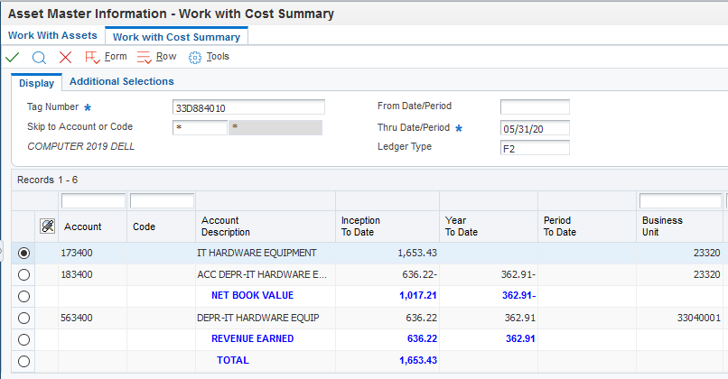
Asset Master-> Asset Balance Info -> Cost Summary
Notice account #’s- both list the “34”
Value of asset posted
Notes:
This is what your asset should look like in E1 when cos

Slide 62
Split Asset Transaction
Doc #: found on Unposted Fixed Asset report, part of the OV batch

Slide 63
Amts. should balance when you hit “save” after all entries
Import excel sheet for multiple entries
Add Tag # to each line

Slide 64
Posting costs to an asset need to be completed within the same month as the receipt if it is being split.
If they are not, a JE must be completed in order to post the costs
Allow ample time between receipting and posting costs to fixed assets
Ex. 5 days before month end, do not receipt any fixed assets!

Slide 65
Fixed Assets: prior month cost posting
Compare the “Fixed Asset No Cost Integrity” report & “Unposted Fixed Asset” report.
Find the cost on the “Unposted Fixed Asset” report (this is an “OV” receipt batch) that aligns with “Fixed Asset No Cost Integrity” report tags.
Notate the document # on the “Unposted Fixed Assets” report

Slide 66
JE approved and posted
Run Unposted Fixed Asset report, and note the document # related to your JE
E1 String:
State of Nebraska>Fixed Assets>Post Fixed Asset Transactions>Revise unposted fixed asset entries
Enter document # from the new Unposted Fixed Asset report, search.

Slide 67
Step 1: Select all DR entries; these costs will be posted.
Row->Post
Tag #’s should be listed here, if not, verify that an Asset Master was created
Step 2: Select CR tab.
Row->revise entry.
Notes:
Once the Dr have been posted, refresh screen. Only CR should show.

Slide 68
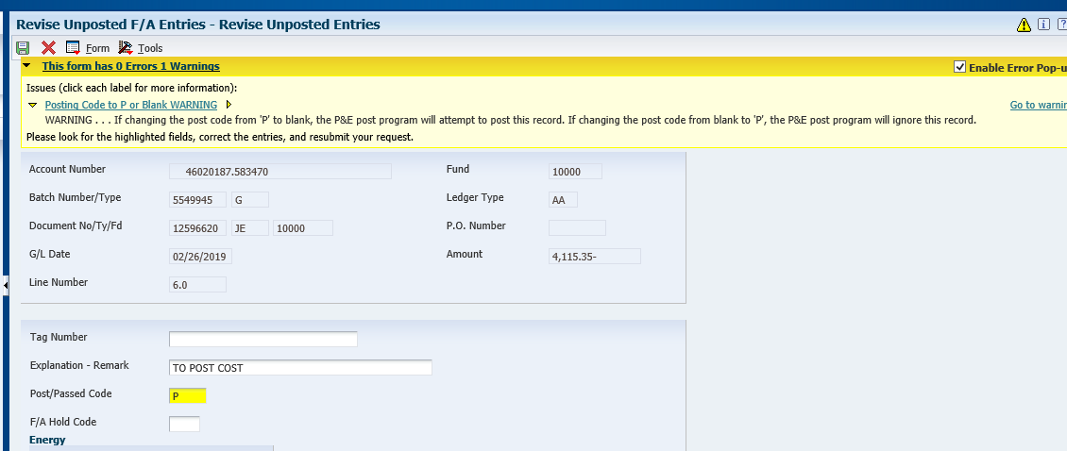
Notes:
When passing on CR, yellow message box appears,
If changing from “blank” to “P” E1 will ignore this record. OK to hit OK again, this is what we want it to do.

Slide 69
Original Unposted fixed asset report, locate the original OV doc #, that was created when the PO was receipted against.
Using the Revise Unposted FA Entries screen, pull up the original OV doc #. Pass on these costs. Notate in description reason for passing on costs.
This will remove the OV receipt entries items from the unposted FA report.
The JE that was created to post costs to the asset replaces the OV Receipt. This is why we are passing on the costs.

Slide 70
Oops! I posted both my DR and CR transactions, now what?
If you accidentally zero out the costs for your fixed asset, by selecting the debit and credit row, then you’ll need to create a new journal entry since the amounts are now zeroed out. State Accounting CANNOT undo this mistake if you post the costs incorrectly. You will have to complete a NEW journal entry.

Slide 71
Summary
Fixed Assets have a direct relationship with Procurement and Accounting functions
Asset Master must be created before costs posted to asset
Post the cost in the same month that the PO is receipted if it needs to be split.
“Split” FA Transactions for multiple items, 1 PO line
Previous month not posted, JE entry
Monthly review of Unposted FA report, FA No cost integrity report and Received not vouchered.

Slide 72
Questions?

